Slide 1
Orchestrating with Docker Swarm
Srinivasan S Iyer

Slide 2
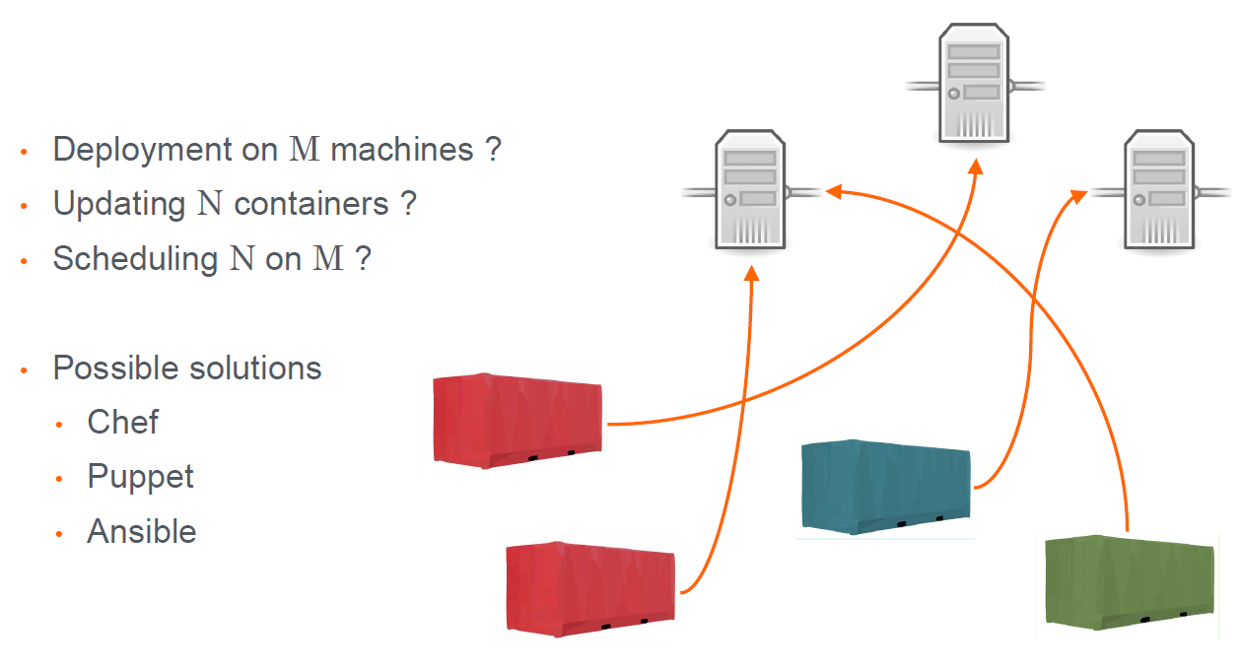
Problems with Independent Docker Hosts

Slide 3
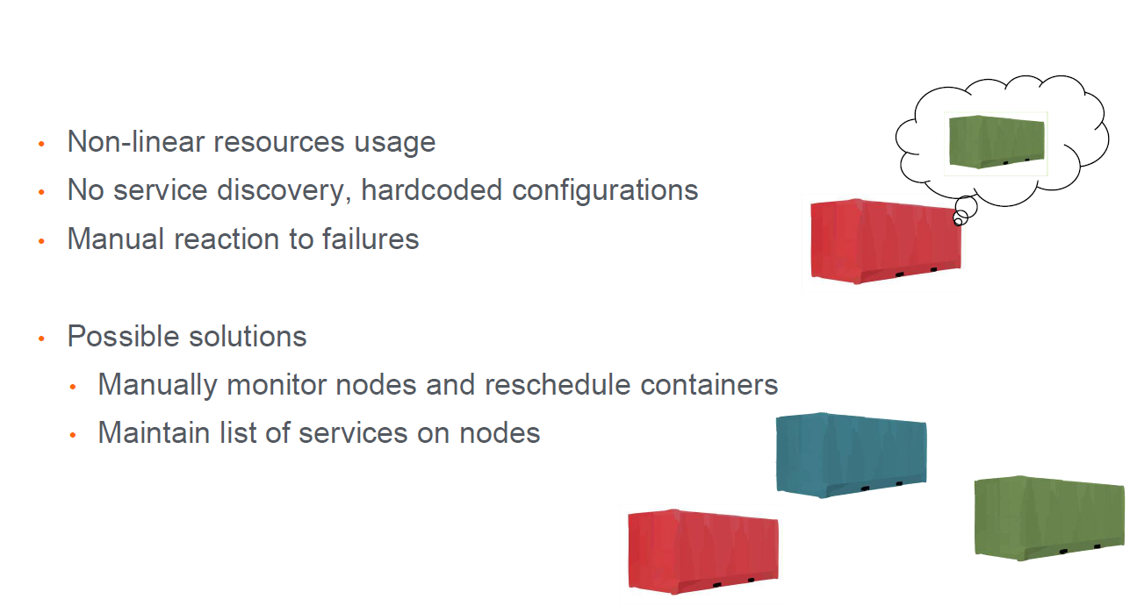
Containers Manually allocated on multiple nodes

Slide 4
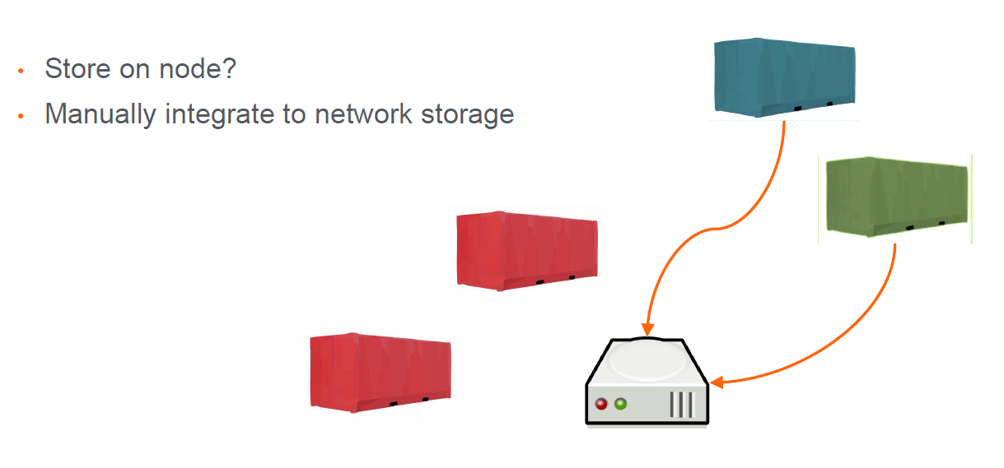
Storage for Containers

Slide 5

Pets VS Cattle
Unique systems that can never be down. Build and managed manually.
“Hand fed”
” When one of them gets sick, you shoot 'em in the head and replace 'em with a new one.”

Slide 6

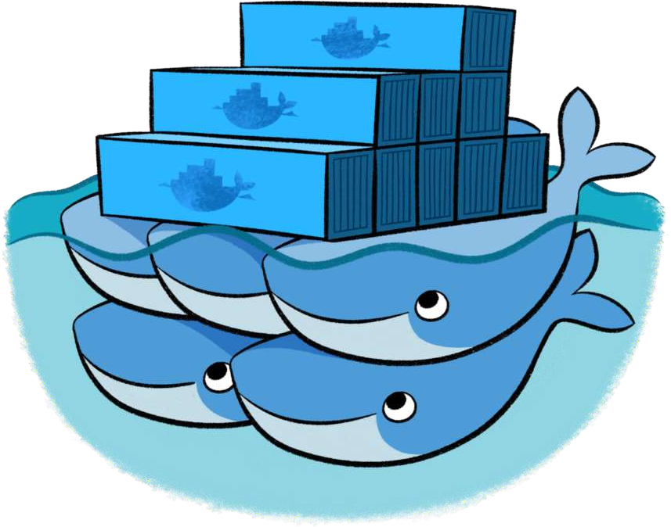

What is Container Orchestration?
Cluster management
Scaling
Service discovery
Load balancing
Networking
Security
Rolling updates
Storage
Configuration
Secrets
...

Slide 7
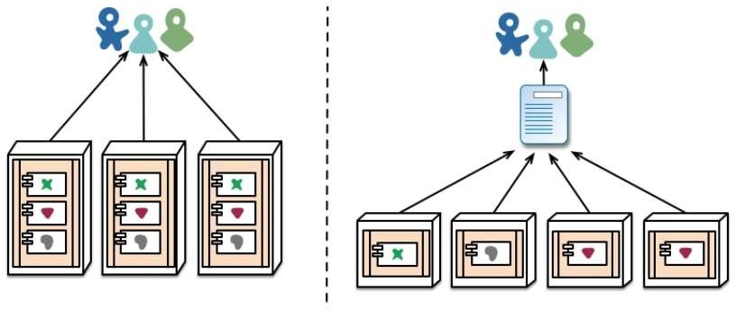
Scaling Services
Declare the number of services you want to run
Scale up or down
Orchestrator automatically adapts to desired state.

Slide 8
Service Discovery
Allow for services in the cluster to locate other services
DNS
API
Load balancing
Running containers
Not dead containers

Slide 9
Load Balancing
Expose services to external users
Distribution of workloads across multiple computing resources
Optimize resource usage
Maximize throughput
Avoid overload of any single resource
Increase reliability and availability through redundancy

Slide 10
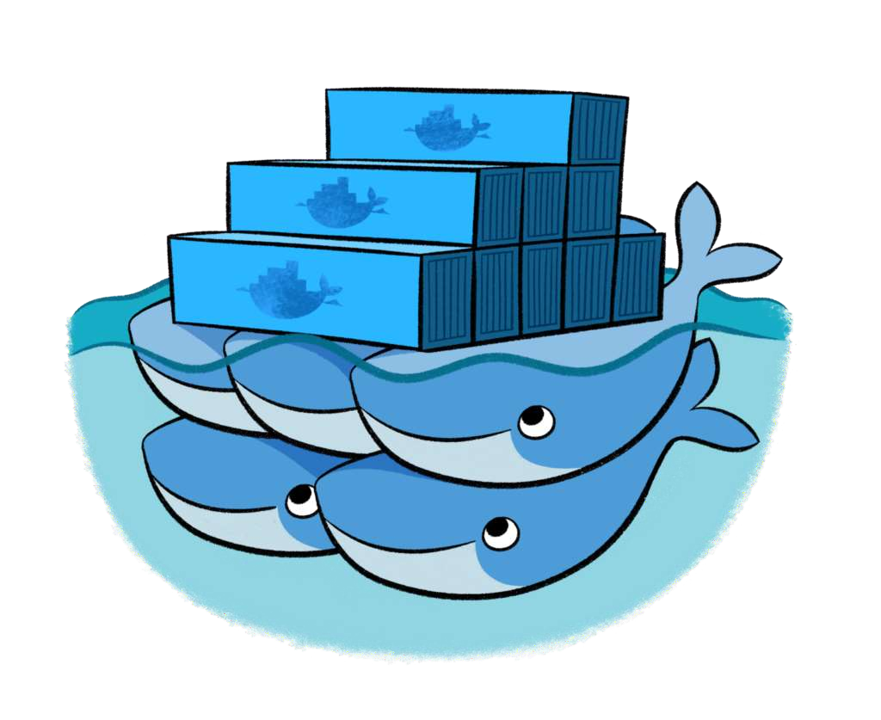
Core consepts
Swarm
Node
Service
Tasks
Load balancing

Slide 11
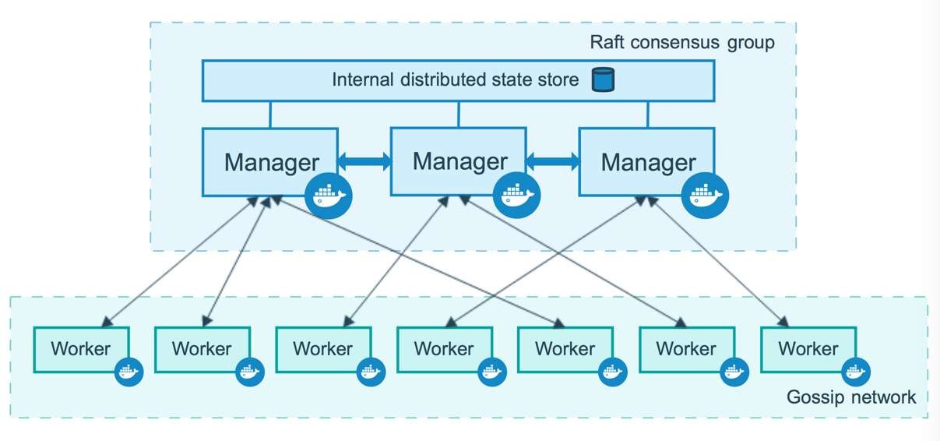
How nodes work

Slide 12
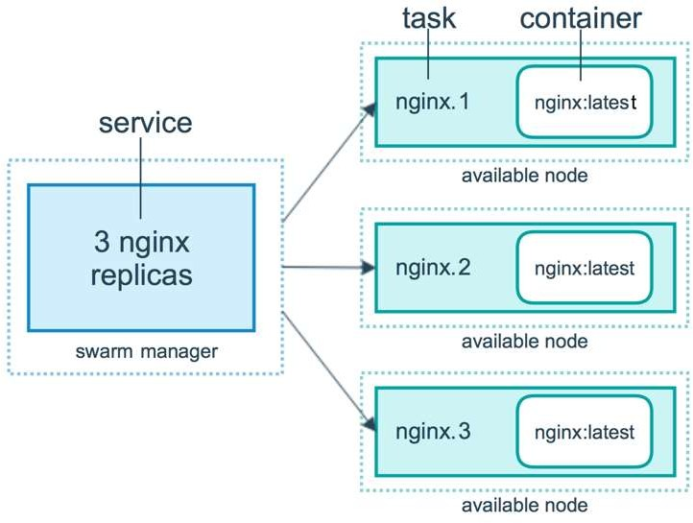
How services work
In a services we specify
Image
Exposing external ports
Overlay network for connecting to other services
CPU and memory limits and reservations
Update policy
Number of replicas

Slide 13
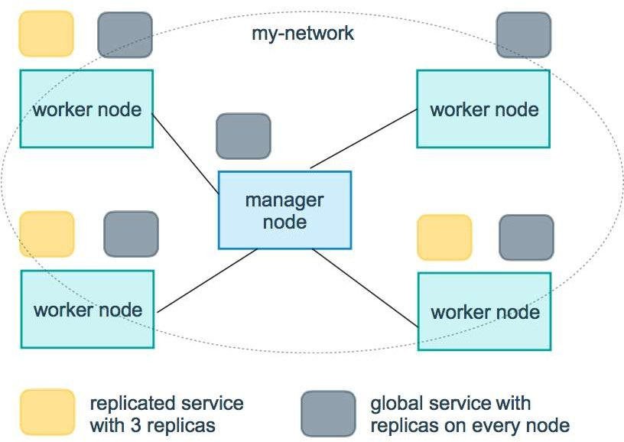
How services work
Replicated
Specify the number of identical tasks you want
Global services
Service that runs one task on every node

Slide 14
Configuration
Environment variables
web:
environment:
- DEBUG
Environment files
web:
env_file:
- web-variables.env

Slide 15
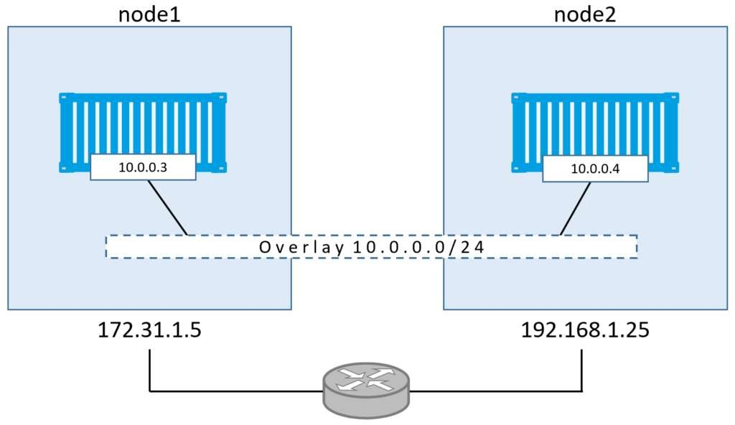
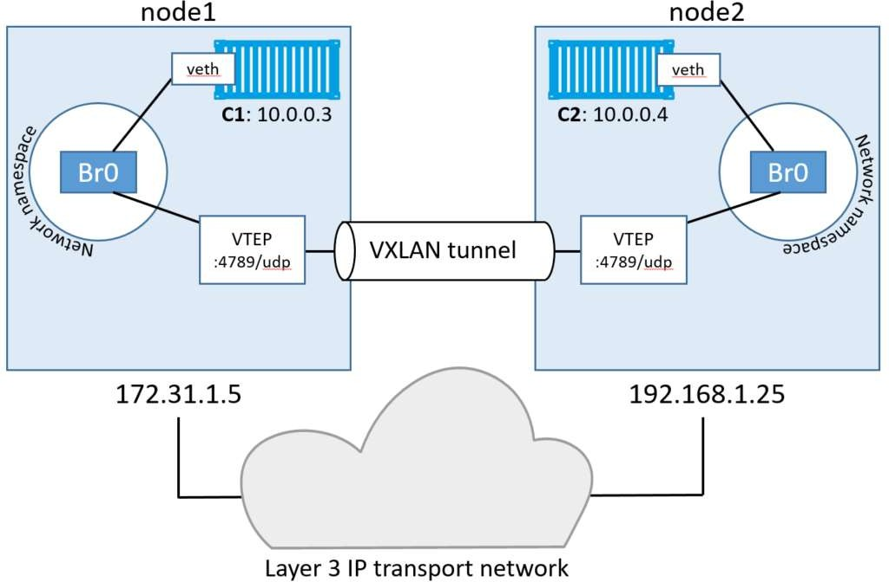
Networks
Develope-editon
Network-guy-edition

Slide 16
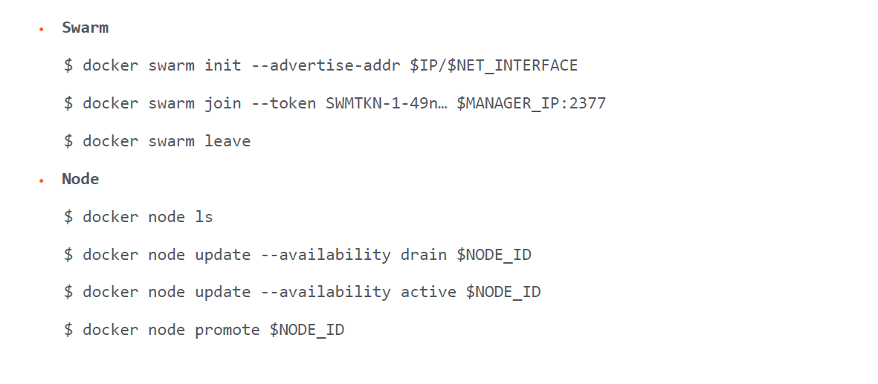
Docker Swarm Cheatsheet

Slide 17
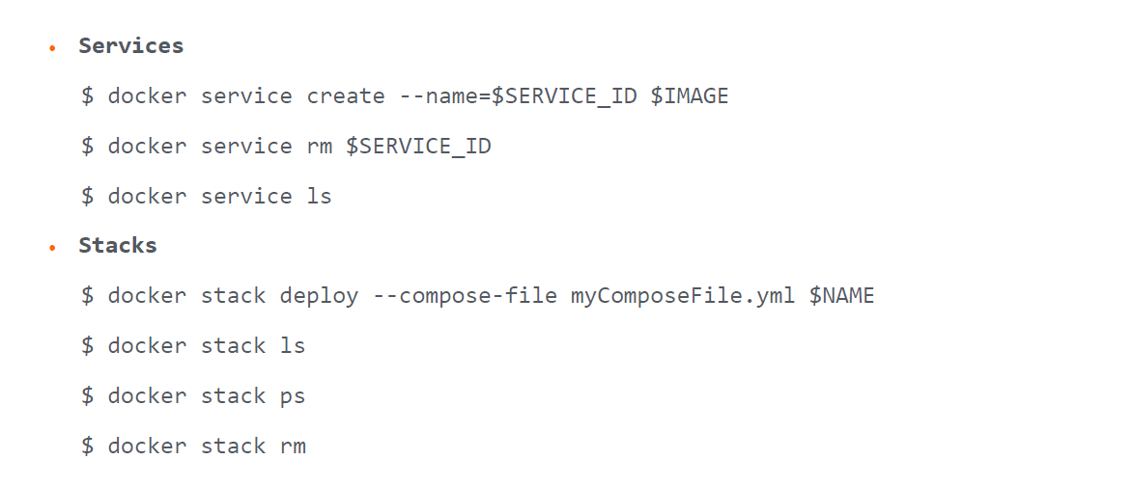
Docker Swarm Cheatsheet

